Slide 1
Development of MEMS based Micropumps for Medical Applications
Shirshendu Chatterjee
Roshmi Bhattacharya
Institute of Radio Physics and Electronics ( IRPE )
University of Calcutta

Slide 2
Contents
Introduction
MEMS and its applications
Wound Therapy
Target of the Project
Design of MEMS based Wound therapy system
Initial Work
Design of Micropumps
Structure Schematic
Working Principle
COMSOL Simulation
Results
Piezoelectric Actuator Simulation
Fluid Transport Simulation
Future Considerations
Fabrication of structures
Design Improvement
System Integration
Application Ranges

Slide 3
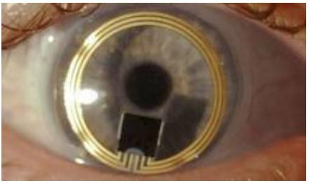
Introduction
MEMS is termed as Micro-Electro-Mechanical Systems.
MEMS have been an important aspect in different domains of technological advancements.
Application of MEMS in medical domain has been elevated in recent years for sensing and actuation purposes.
But, there has been a dearth of MEMS based devices for fast and effective treatment of wounds.
http://www.eeherald.com/section/design-guide/mems_medical.html

Slide 4
Wound Therapy
Vacuum Assisted Closure or Negative-pressure wound therapy, is a therapeutic technique using a suction pump, tubing and a dressing to remove excess exudates and promote healing in acute or chronic wounds and second- and third-degree burns.
How does it work?
During the treatment, a device decreases air pressure on the wound. This can help the wound heal more quickly. The gases in the air around us put pressure over the area of the wound.
The therapy involves the controlled application of sub-atmospheric pressure to the local wound environment using a sealed wound dressing connected to a vacuum pump.
Vacuum therapy is a non-invasive massaging technique that helps to lift your skin via a mechanical device equipped with suction cups.

Slide 5
Target of The project
There are no devices to mitigate the wounds inside the body, which serves as the main motivation for our work.
To strike the problem of in-vivo wounds a micropump is to be designed, which will remove the exudates and to keep the wound clean and help fast healing of the wound.
The micropump should be of compact size in the order of millimetres to centimetres.
A sensor will also be incorporated to check the real time vitals of the patient.
Fabrication of the devices will be done to be ready for implementation.

Slide 6
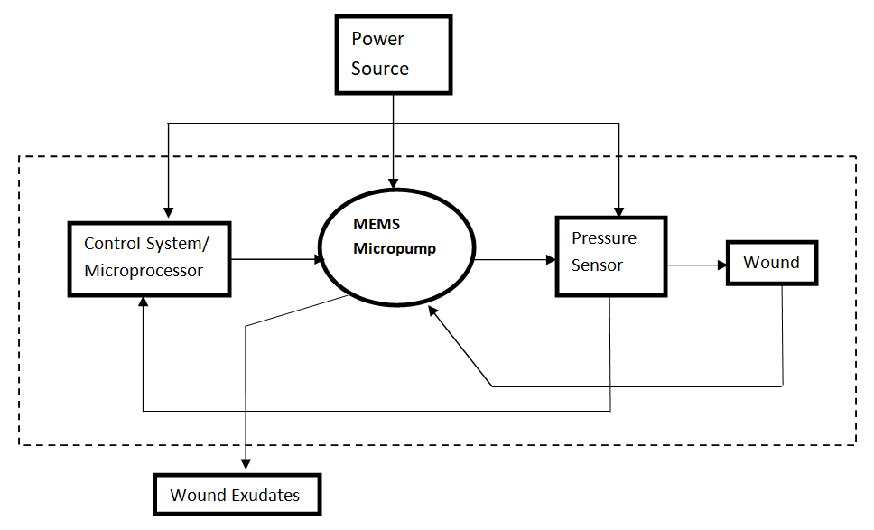
Design of MEMS based Wound therapy system
The schematic of the design of MEMS based wound therapy system is shown.
A power source is applied to the system. The whole pumping mechanism is controlled by a control system.
After pumping the exudates are taking out of the system for further operations.

Slide 7

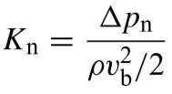
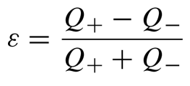
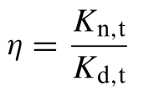
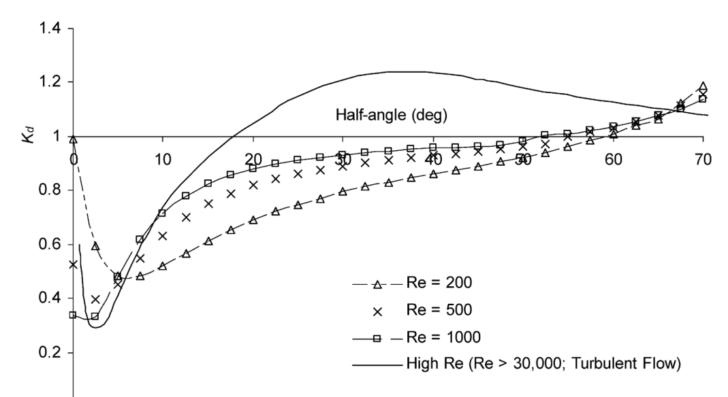
Design of Micropump
Theoretical Analysis
For the ease of fabrication, and cost effectiveness, a nozzle diffuser micropump was chosen to be implemented.
The structure shows two diffuser elements. The conical diffuser element was chosen.
To analyze the working of the diffuser element, pressure loss coefficient, flow rectification efficiency and diffuser efficiency was taken in consideration.
The pressure loss coefficient is defined-
The flow rectification efficiency (Ɛ)is given by-
The nozzle efficiency of the diffuser is –
After analyzing, it was determined the best
efficiency of the diffuser element served at
diffuser angle of 9˚ for low Reynolds number
Complying with the theoretical analysis, the
dimensions and structure was determined.

Slide 8
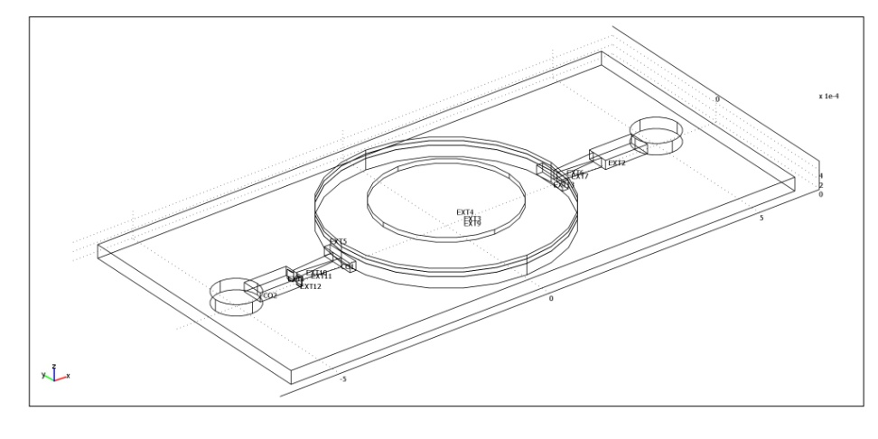
Design of Micropump
Structure Schematic
The structure shows two conical diffuser elements with fully developed inlet chamber.
The fluid goes in the inlet, through the chamber and gets pumped out through the outlet
The chamber is covered by a actuator which changes the pressure inside the chamber thus actuating the pumping action.
The designed micropump is shown below.
The micropump is of size 1.2cm*0.6cm. The thickness of the substrate is 350µm.

Slide 9
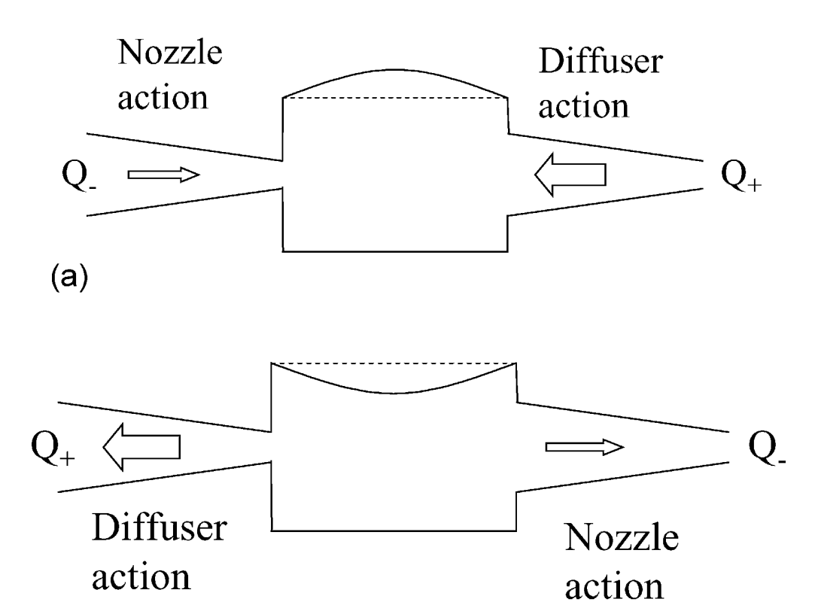
Design of Micropump
Working Principle
There are two modes of operation of the pump-expansion mode, contraction mode.
In Expansion mode- The volume of the pumping section increases more fluid enters the pumping chamber from the diffuser than the nozzle.
In the contraction mode, more fluid goes out of the element on the left which now acts as a diffuser, while the element on the right acts as a nozzle.

Slide 10
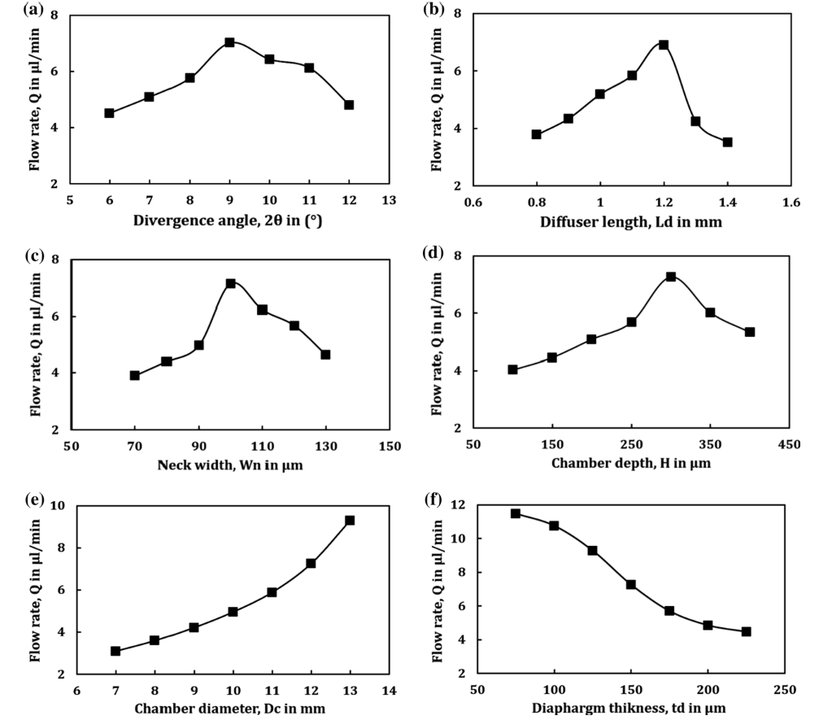
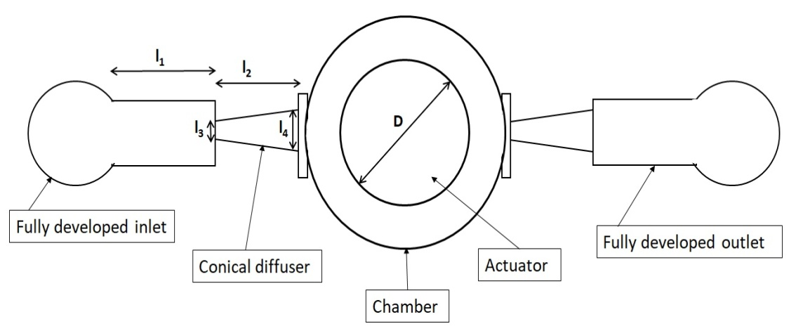
COMSOL Simulation
Dimensions of the Micropump
Description | Value
Length of the inlet chamber(l₁) | 1mm
Length of the diffuser(l₂) | 1mm
Chamber Diameter(D) | 5mm
Actuator Diameter | 3mm
Neck width(l₃) | 100µm
Neck width-outflow(l₄) | 260µm

Slide 11
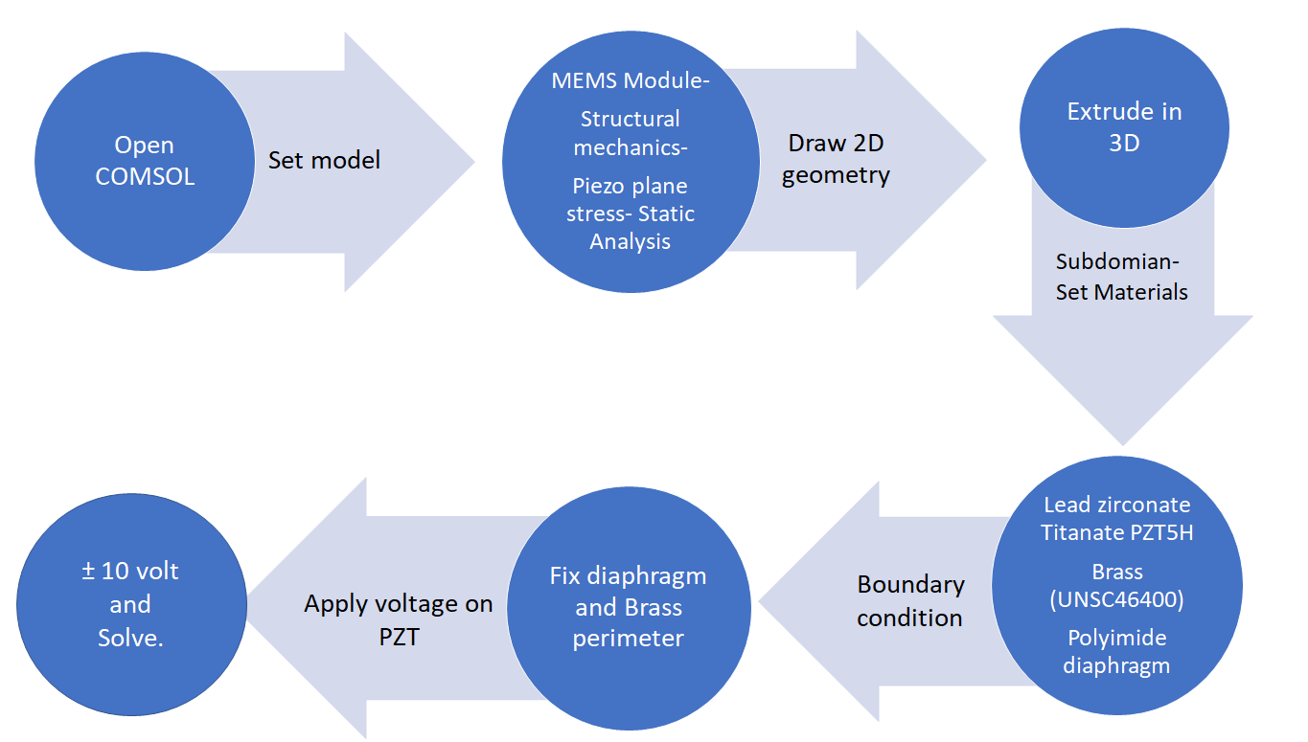
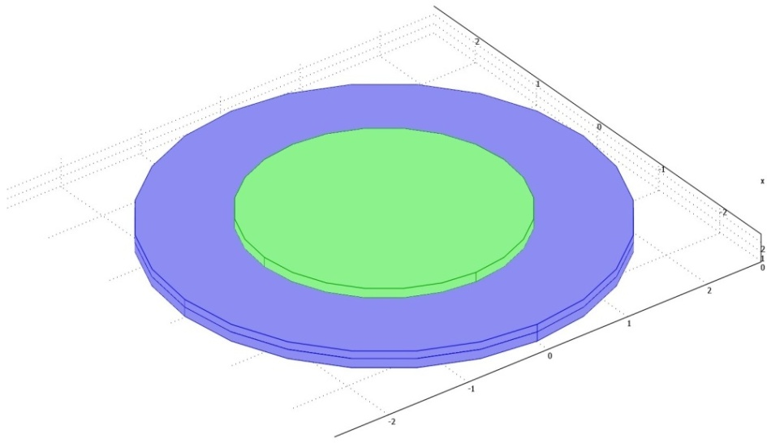
COMSOL Simulation
Piezoelectric Actuator
Description | Value
Diameter and thickness of the Diaphragm | 5mm, 100µm
Diameter and thickness of Brass | 5mm, 100µm
Diameter and thickness of the Piezo Material | 5mm, 100µm
Description | Material Used
Diaphragm | Polyimide
Piezoelectric Actuator | PZT-5H
Substrate | Brass

Slide 12
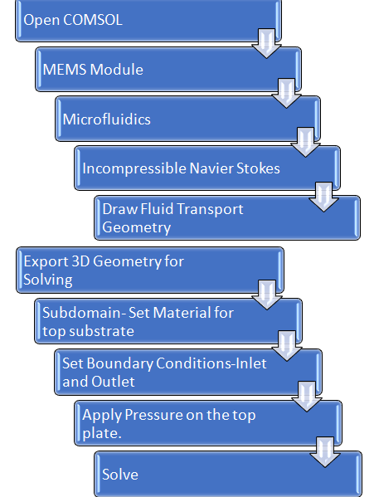
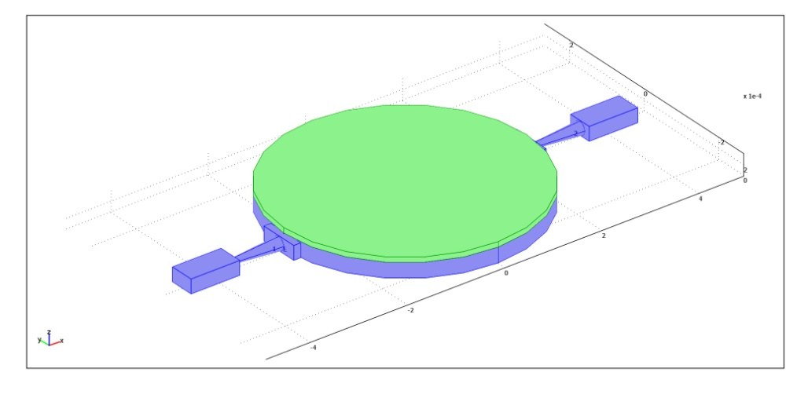
COMSOL Simulation
Fluid Transport Geometry
Description | Value
Length of the inlet chamber(l₁) | 1mm
Length of the diffuser(l₂) | 1mm
Chamber Diameter(D) | 5mm
Top Plate Diameter | 5mm
Neck width(l₃) | 100µm
Neck width-outflow(l₄) | 260µm

Slide 13
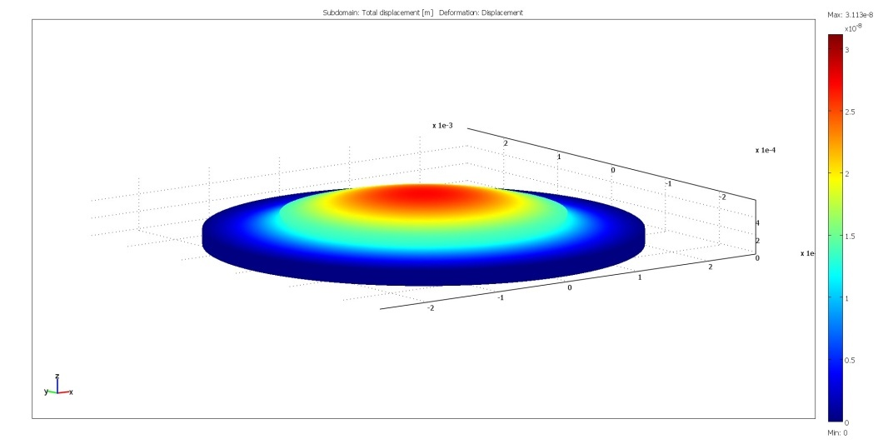
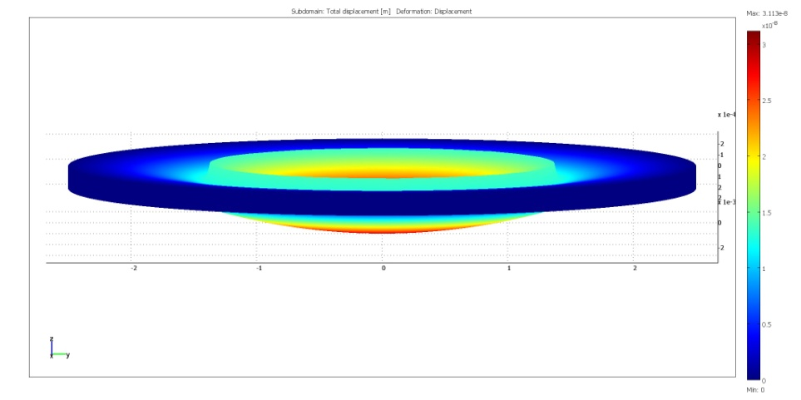
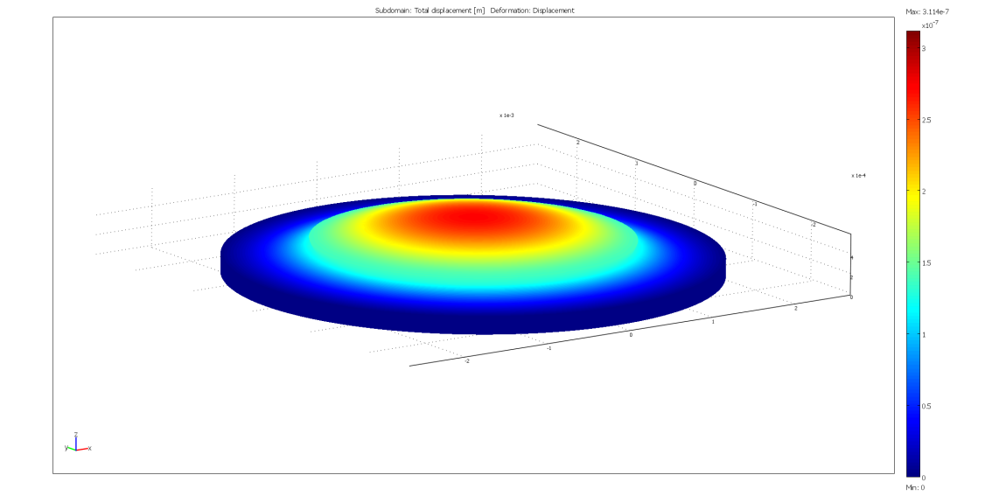
Results
Piezoelectric Simulation-
As a potential of +10V is applied to
the piezoelectric actuator, the
actuator forms a concave surface
and it bends upwards.
When a potential of -10V is applied,
the actuator bends inwards as shown.

Slide 14
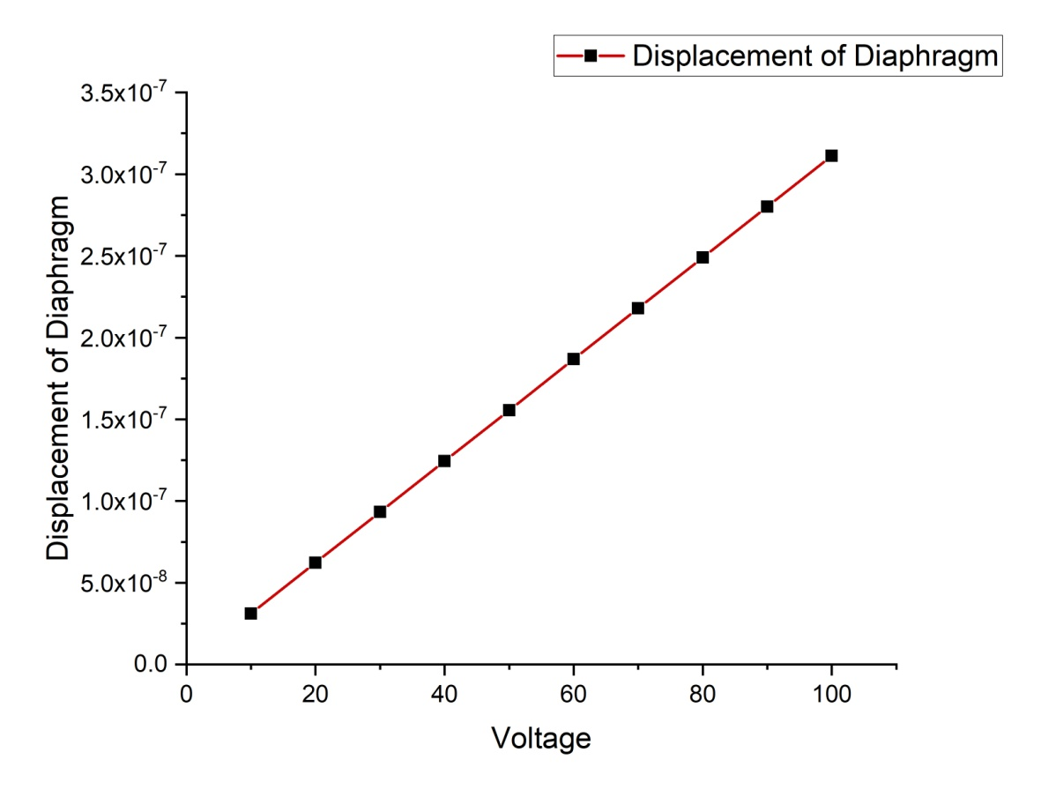
Results
Piezoelectric Simulation-
An analysis of how much there is the deflection of the diaphragm with the change in potential applied was observed.
The graph shows a linear curve, thus depicting linear increase of the diaphragm with the change in voltage.

Slide 15
Results
Fluid Transport Simulation-
Inflow characteristics-
The fluid transport of the Micropump was seen. In the inlet a velocity of 0.1m/s was set. The outlet was set to have a laminar outflow.
It is observed a maximum velocity of 0.682m/s near the neck of the diffuser element. The inflow of the fluid is shown.

Slide 16
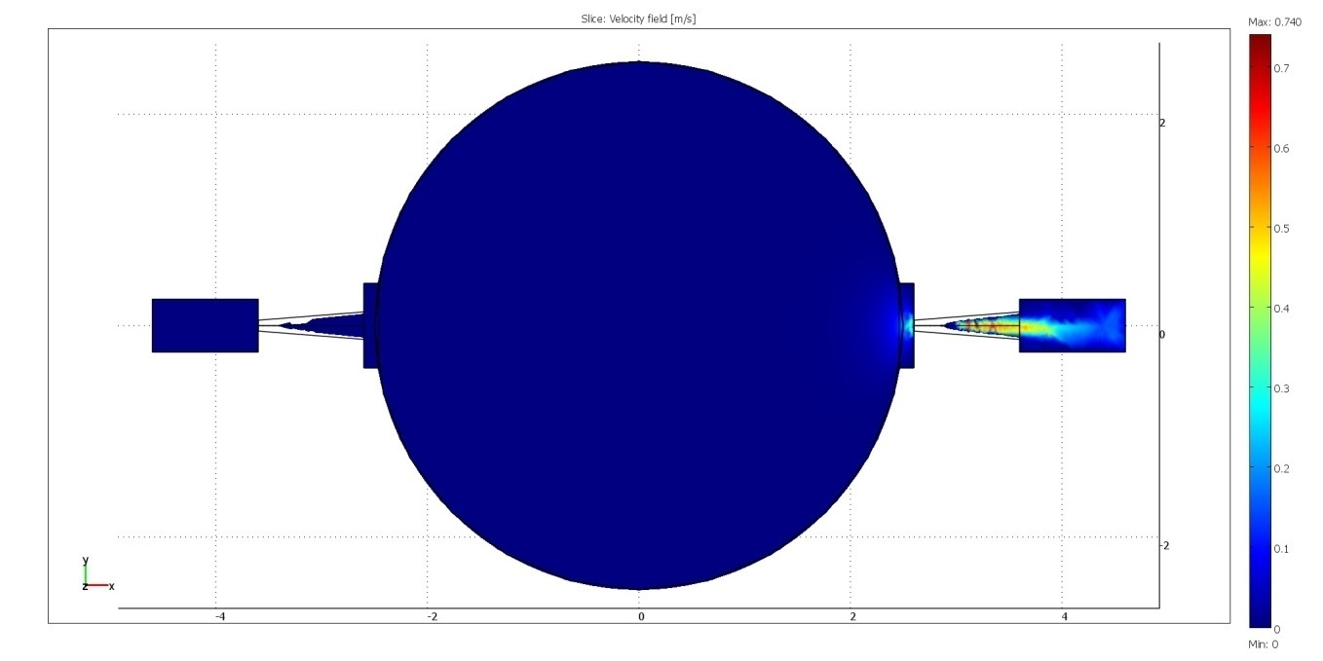
Results
Fluid Transport Simulation-
Outflow characteristics-
Here for the outflow, we have set the outlet velocity at 0.1m/s and for inlet laminar inflow.
As the top plate is pressed down, the fluid ejecting out of the chamber with a maximum velocity of 0.740m/s.

Slide 17
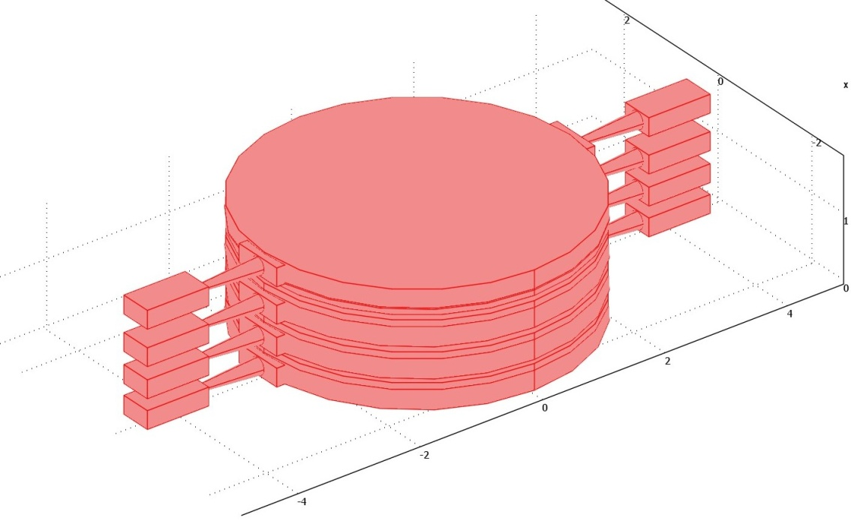
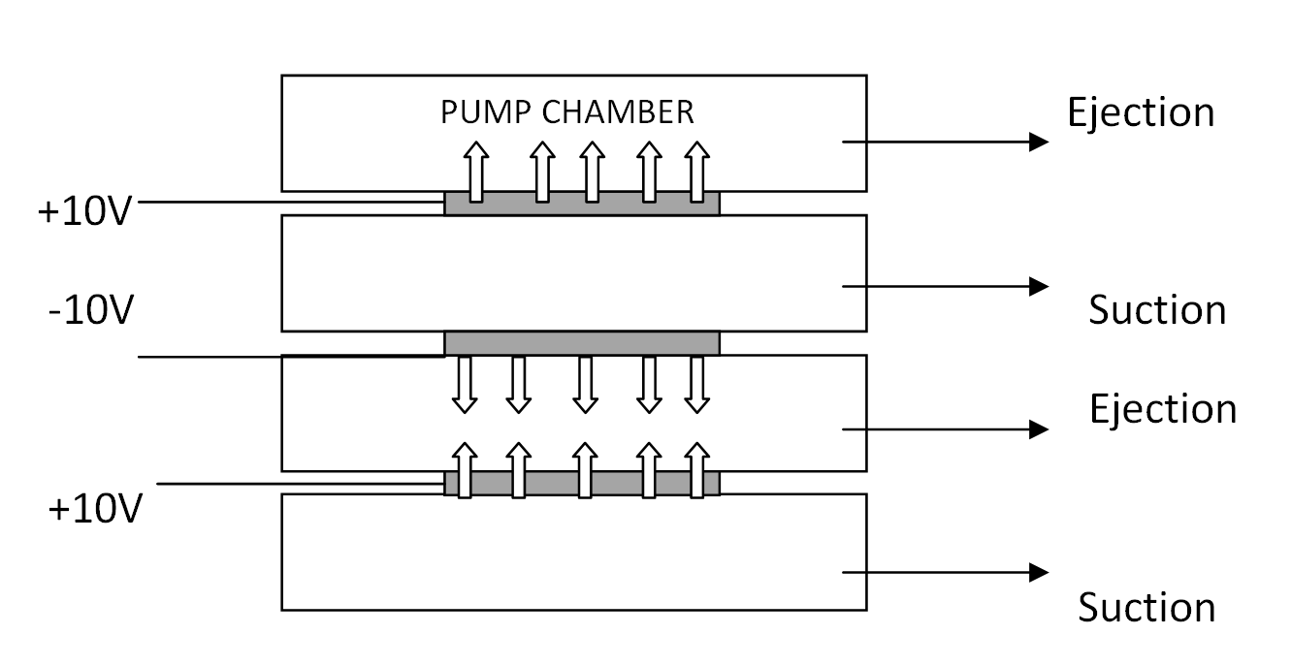
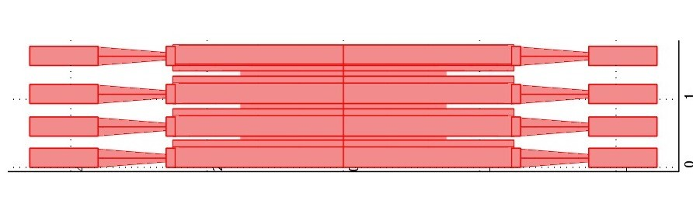
Future Considerations
Design Improvement
A sensor along with the micropump is to be incorporated to check the real-time vitals.
As we finish designing a single micropump, the design of such can be extended for modifications to increase the flow rate of the pump.
One such design modification is shown below.

Slide 18
Future Considerations
Fabrication of Structures

Slide 19
Future Considerations
System Integration

Slide 20
Application Ranges
The whole system can have several application in medical domain.
This device can be attached with the front of the imaging probe for endoscopy, and can attach to cuts inside the body after taking samples.
For laparoscopy, cuts of 1-1.5cm is made. Our device’s dimension is sufficient enough to mitigate the cut for such purpose

Slide 21
Conclusion
We have designed a piezoelectric valveless micropump

Slide 22
Acknowledgement
We would like to thank Dr. Anirban Bhattacharyya, Assistant Professor, Institute of Radiophysics and Electronics, University of Calcutta for his immense help and guidance for the organization of the project
We would like to thank COMSOL India for providing such platform for simulation of our devices.

Slide 23
Thank You

